Slide 1


Where should a chef open a restaurant in Toronto?
Capstone Project - The Battle of Neighborhoods

Slide 2

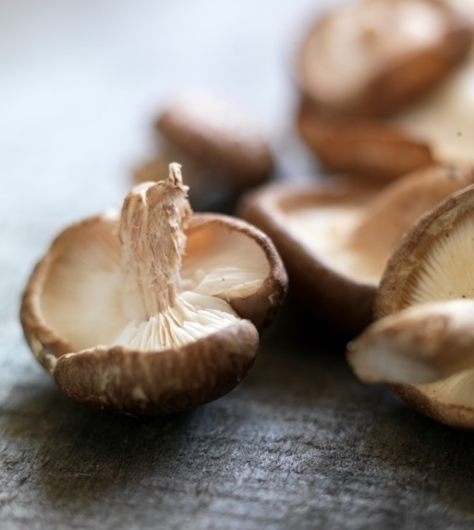






Context
Chef Jacques Durand
New Restaurant in Toronto
Where should I open it?

Slide 3


DATA SOURCES
Foursquare API
Restaurant location
and popularity
Wikipedia
Postal Codes and location

Slide 4
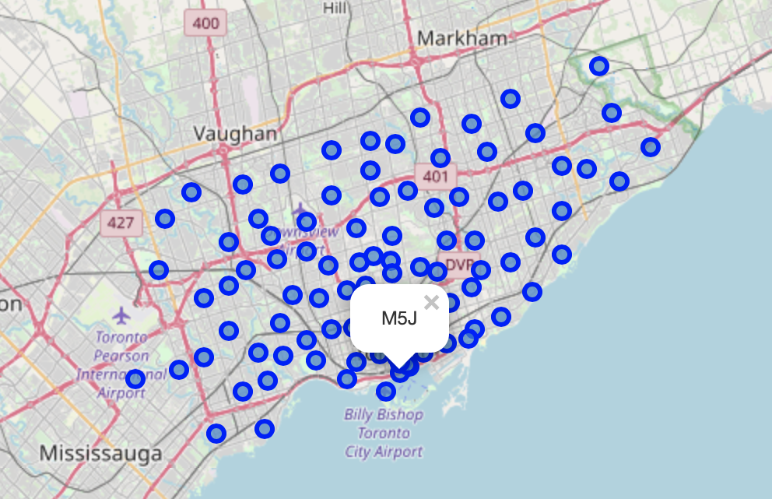
Data Preparation
Three Steps:
Scrape postal code from the Wikipedia page using python library BeautifulSoup
Combine the extracted postal codes with their latitude and longitude
Use the explore Foursquare API call to get all venues associated with a Postal Code.

Slide 5
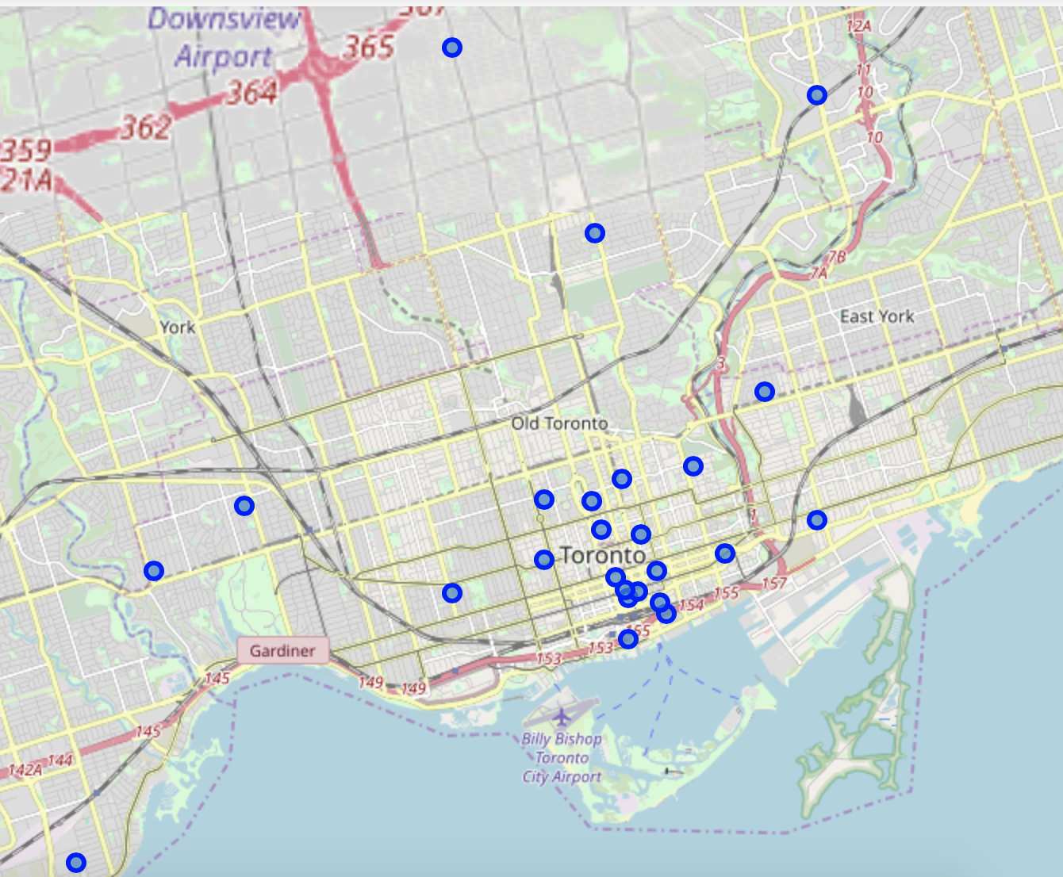
Data Exploration
Which neighborhoods contain the most restaurants?

Slide 6
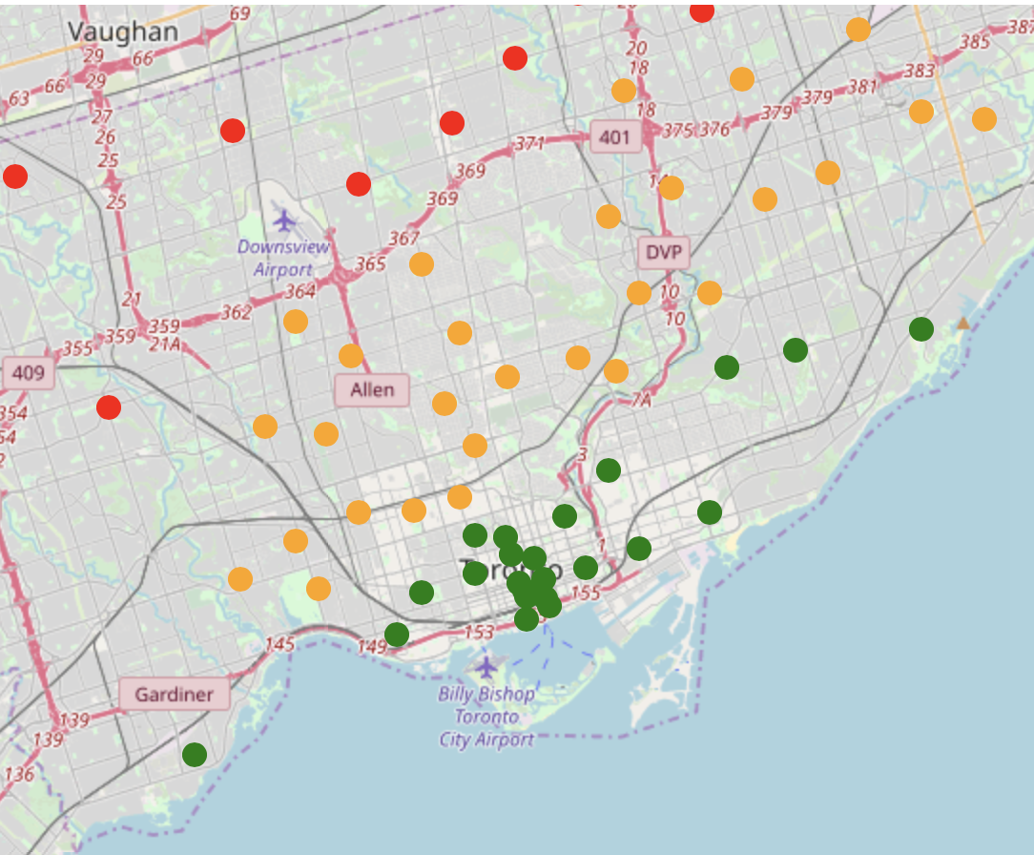
DATA Modelling
Model
Type: Linear Regression
X: Venue Latitude & Longitude
Y: Venue Rating
MSE: 2.81
R2: 0.38
Prediction per postal code
red = rating <5
orange = rating between 5 and 7
green = rating > 7

Slide 7
CONCLUSION
Recommendations
Known limitations
Data exploration and data modelling show consistent results
Recommendation is to open restaurant in center city Toronto
Foursquare maximum number of calls
Limited number of success metrics
Poorly performing model

Slide 8
Thank you
paul.vid@gmail.com

